Slide 1
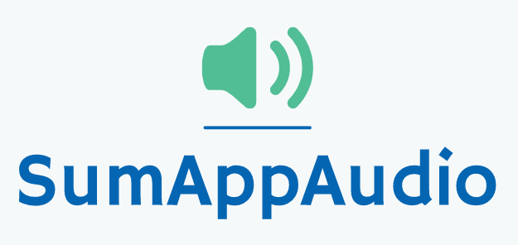
Second checkpoint
Group 4
Marco Carfora
Daniele Calisi
Francesco Bovi

Slide 2
Business concept
During the last years the awareness on the dyslexia is increased. Indeed, it has been registered a raise of students with certified dyslexia (177.000 cases in Italy), from 0.7% in 2010 to 3.2% in 2018 but the number is probably higher.
Students affected by dyslexia have difficulties in reading a text and troubles copying from the blackboard. They don’t have a way to easily grasp the concepts and to make the comprehension faster, indeed they usually need external help, like a tutor.
Sum-AppAudio is a mobile platform based on a student-to-student model to support the study of students with dyslexia. The core of the App are the recorded files that the every student can upload to summarise subject topics or book chapters. The system is designed ad hoc to overcome the difficulties that students with dyslexia have to face but also other students can enjoy the service.

Slide 3
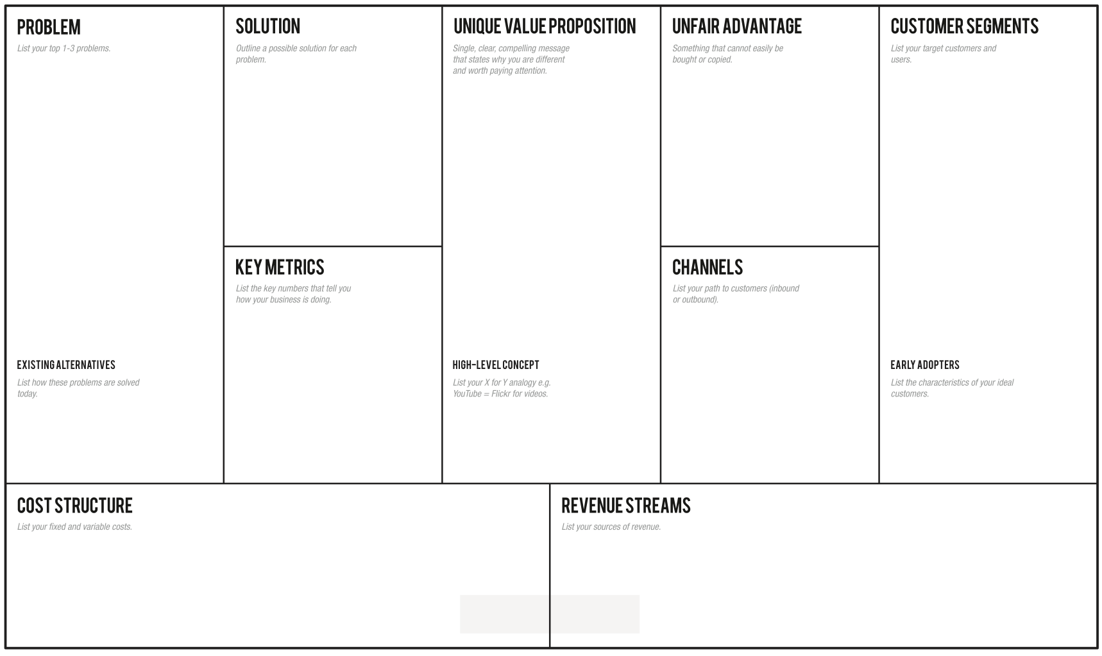
-Students with dyslexia have difficulties in reading and comprehending a text:
-They don’t have a way to easily grasp the concepts, making the learning slow.
-They need an easy way to autonomously review school subjects, indeed they usually ask for external help
Through the app the students can learn in an easier and efficient way, avoiding tiring readings, relying on recordings from a huge collection built thanks to a lot of students' support
Overcome your reading and learning difficulties, enjoy a student-to-student model whose core are the recorded files that every student can upload to summarise subject topics or book chapters for students with dyslexia.
-Students with dyslexia problems (2% from primary schools, 5.6% from middle schools, 4.7% from high schools).
-Schools and pedagogical associations -Support teachers.
-Every student who want to help other ones.
-Number of produced and listened recordings (monthly).
-Content quality trends thanks to feedback system.
-How many results appear for a single topic.
-How many people use the app regularly (rate of accesses)
-Flyers distribution in front of selected schools and associations of this sector.
-A social page dealing with dyslexia problem.
-Meetings in school where we present our project to students.
- Select classes with a dyslexic student in Rome schools, so classmates can help each other -Tutors / Support teachers
Skuola.net, ad hoc textbooks, Youtube, voice synthesizers, tutors, concept maps
Sum-AppAudio = Spotify for school summaries.
-Server/database maintenance;
-Channels’ cost;
-(Eventually) Reward system costs (Gift Cards);
- Cost of the application in the mobile store;
- Partnerships with schools/associations;
- Partnerships with publishing companies to certify their content;
- Banner advertisements;

Slide 4
Validation Plan
Assumptions we have validated:
How:
The interest of dyslexic students and tutors to use the app;
The interest of non-dyslexic students to upload recorded files;
The usefulness of the audio model for dyslexic students; .
Surveys/questionnaires on social networks;
MVP: give audio files to dyslexic students verifying their comprehension quality;

Slide 5
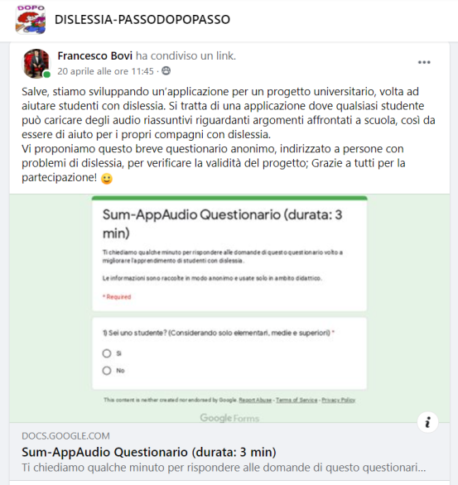
Students Questionnaire
CONTENT SUMMARY:
Degree of satisfaction with the current study method (only for dyslexic students).
Degree of satisfaction with the supporting material available (only for dyslexic students).
Usefulness of the student-to-student audio system (only for dyslexic students).
Availability in uploading recordings (with or without incentives).
Addressed to: Scholars and ex-students, dyslexic and not.
Where: Our contacts, facebook groups about dyslexia.
Questionnaire Link: https://forms.gle/JzLLyL3t9WeL8Aqm6

Slide 6
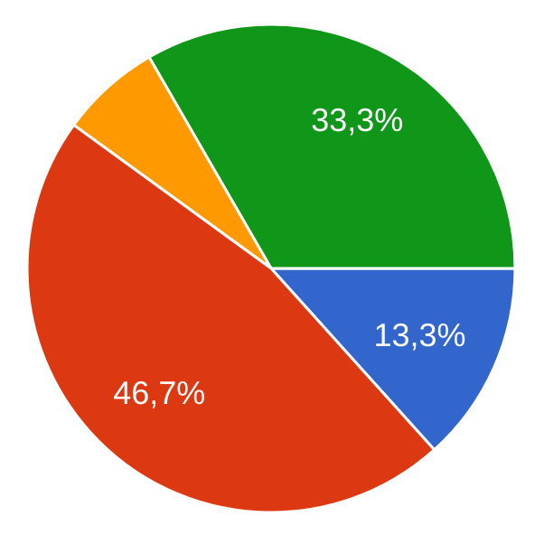
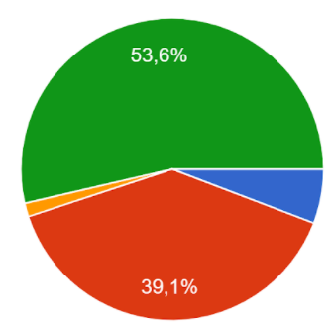
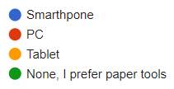
Results of the Students questionnaire (1/4)
Which technology did you use the most during the study?
Students: Ex-Students:
We can clearly see a trend in which new generations of students prefer electronic devices during the study than paper tools.
Moreover, the use of PC is predominant, but the use of smartphone is increasing;
Action:
The application should be developed both for PC and smartphone, not only on the latter as we initially thought.
Total number of answers: 131
Grouped by:
Dyslexic Students: 15
Dyslexic ex-Students: 13
Non-Dyslexic Students: 34
Non-Dyslexic ex-Students: 69

Slide 7
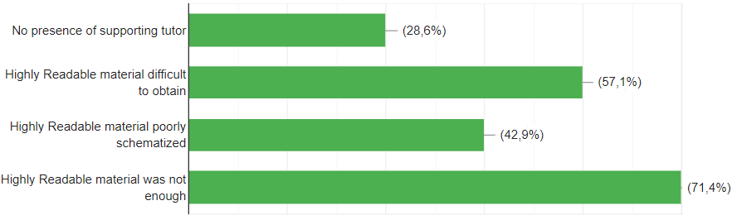
Results of the Students questionnaire (2/4)
We’ve seen that compared to ex-students, the new generations are generally more satisfied with their study method, but there are some issues that are still problematic:
Most common dissatisfaction reasons:
We’ve seen that compared to ex-students, the new generations of dyslexic students are generally more satisfied with their study method, but there are some issues that are still problematic:

Slide 8
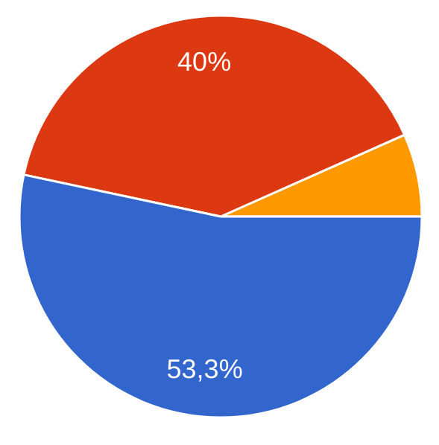

Results of the Students questionnaire (3/4)
Why? (positive answers) - 93,3%
They would be direct and easy to comprehend (50%)
it would speed up the study (42%)
They would help me to better grasp and memorize the concepts (35%)
Why? (negative answers) - 6,7%
Audio could be incorrect or unreliable (40%)
Audio would be difficult to understand (20%)
Concepts could be badly explained (60%)
To avoid an unreliable system we have a feedback system based on other students and tutors marks.
Question: (for dyslexics only): Do you think that audio summaries, made by other students, could help you in the study?

Slide 9
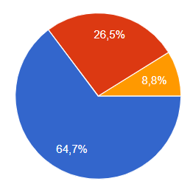
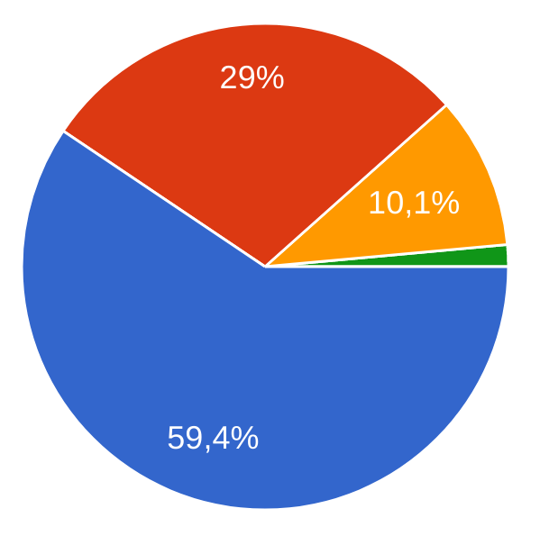
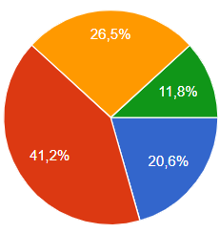
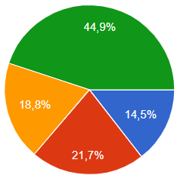
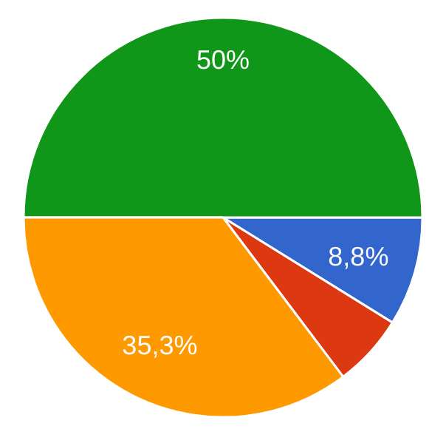
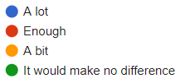
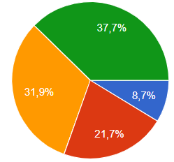
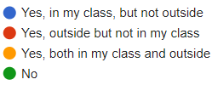
Results of the Students questionnaire (4/4)
Would you be willing to upload recordings in the App?
Students Ex-students
We can highlight a trend: new generations of students are more available to help their acquaintances with recordings
With respect to the question above, how much you would change your answer if the App included a reward system (based on Gift Cards)?
Students Ex-Students
Action: We decided to remove gift card for the first period
Questions:
Do you know dyslexic students? If yes, they are in your class or outside of it?
Students Ex-Students

Slide 10
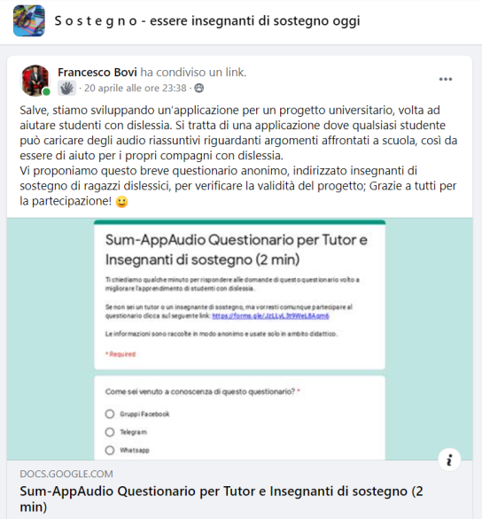
Tutor
Questionnaire
CONTENT SUMMARY:
Degree of satisfaction with student’s current study method.
Degree of satisfaction with the supporting material available.
Usefulness of the student-to-student audio system.
Availability in the evaluation of the recordings.
Addressed to: Support teachers and private tutors;
Where: Our contacts, facebook groups about school tutoring;
Questionnaire Link:
https://forms.gle/CLrzM3CAkxBQKcDU7

Slide 11
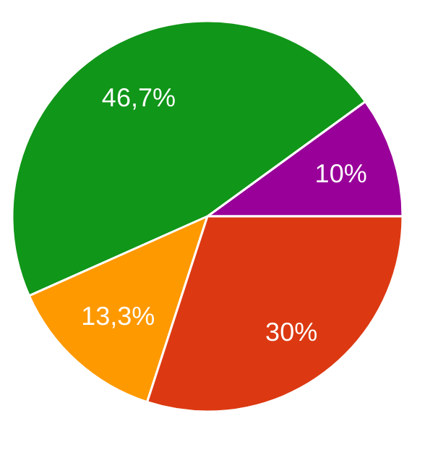
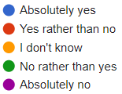
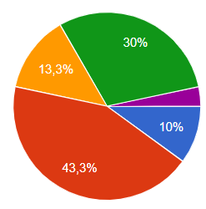
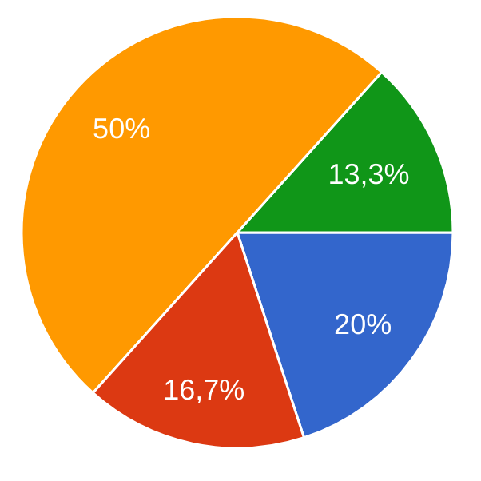
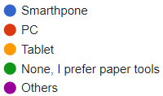
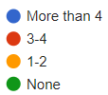
Results of the Tutor questionnaire (1/2)
Are you satisfied with educational tools to teach to dyslexic students
Which technology do you use the most to support your students?
Total number of answers: 30
Questions:
How many dyslexic students do you follow weekly?

Slide 12
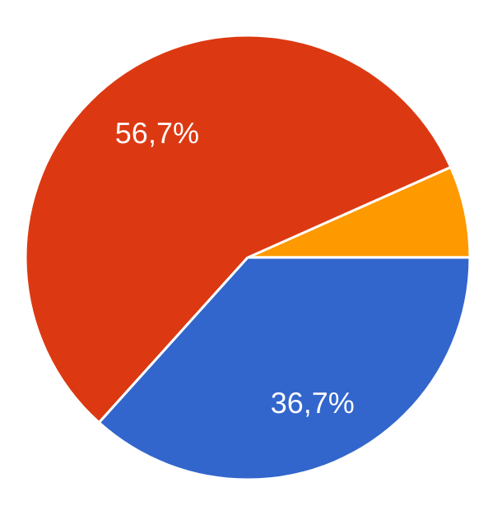
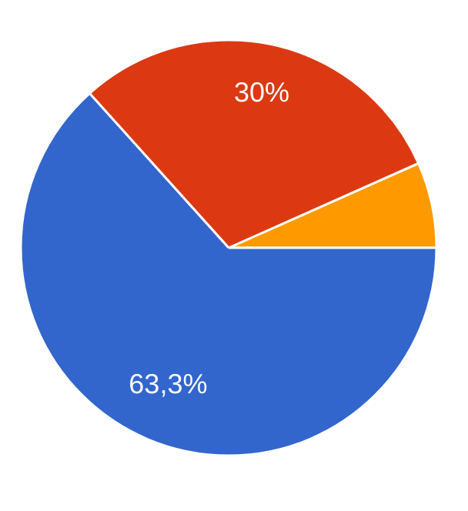
Results of the Tutor questionnaire (2/2)
Questions:
Do you think that audio summaries, made by other students, could help dyslexic students?
Would you be willing to leave feedbacks to certify the best recordings?

Slide 13
Comments from questionnaires
Actions:
Add: guidelines for audio creators (specific titles, clear concepts, loud voice, short recordings, repetition of principal concepts, chronological order)
Add: optional concept maps together with the recordings
Add: show up authors nicknames
Suggestions:
Audio content quality must be high;
Concept maps attached can help to understand better recordings;
Highlight the nickname of the content’s creator;
It can be useful also for other disorders (blindness, loss of concentration).

Slide 14

Minimum Viable Product
What:
To verify the usefulness of the audio system for dyslexic students, we have contacted a few and provided them some audio recordings; they listened the audio and evaluated the quality, thus to give us a feedback.
Audio samples:
Addressed to: Dyslexic students;
Where: Through our contacts (family, friends, acquaintances)
Respiratory System
Assyrians
Athens
Sparta

Slide 15
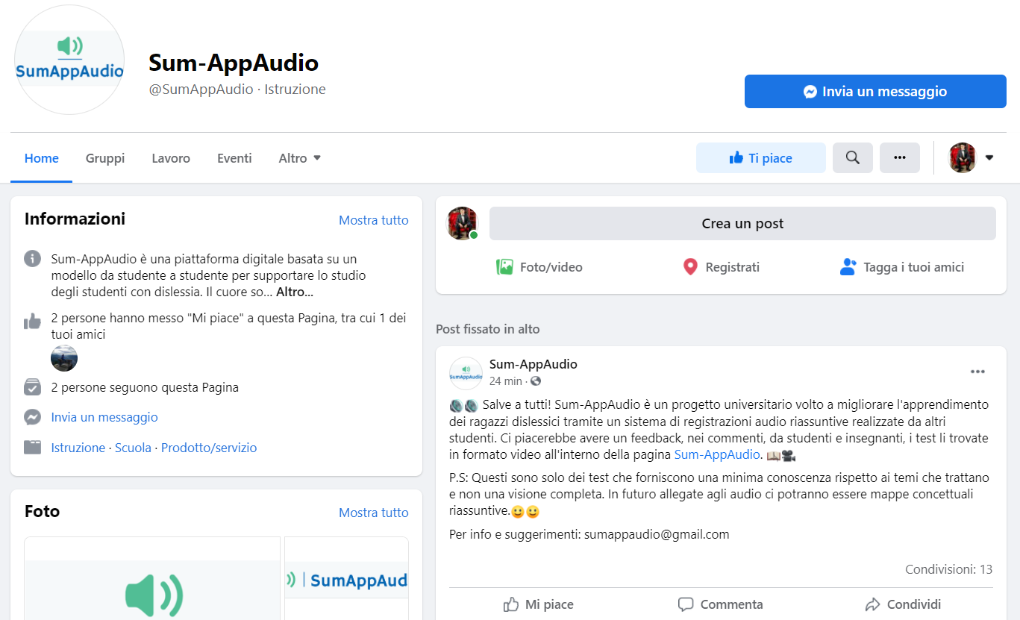
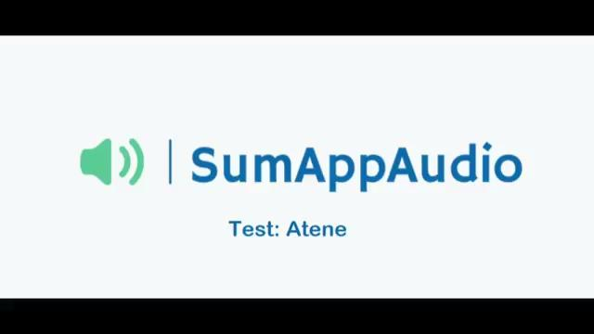
Landing Page
What:
A landing page, with all information about the application, that offers the possibility to hear the audio samples and give a feedback.
Goal: Expand MVP audience
Where: Shared on Facebook groups about dyslexia.

Slide 16
Actions Summary
The application should be developed both for PC and smartphone, not only on the latter as we initially thought
Remove: gift card for the first period
Add: guidelines for audio creators (specific titles, clear concepts, loud voice, short recordings, repetition of principal concepts, chronological order)
Add: optional concept maps together with the recordings
Add: show up authors nicknames

Slide 17
THANK
YOU!

